Slide 1
Part 3:
ML optimisation

Slide 2
Lesson concepts
ML optimisation:
Test train split
Standardisation
Bias/variance
Underfitting/overfitting
L1/L2 regularisation

Slide 3
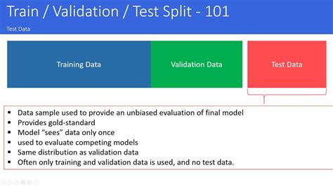
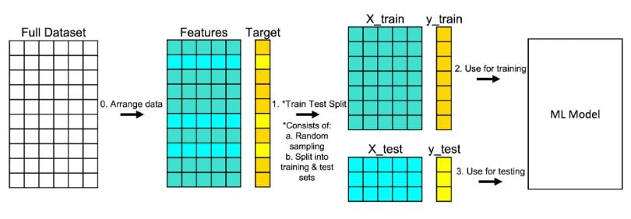
Train/test split

Slide 4
Exercise
Lets practice in Jupyter

Slide 5
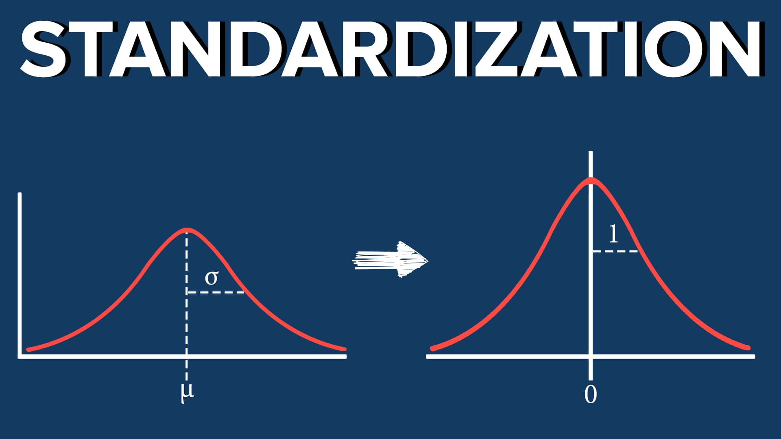
Standardisation
Makes data consistent in scale
If we will scale the data evenly in such a way that the data points are mean centric and standard deviation of the distribution is 1 then the weights will be treated equally by the algorithm giving the more relevant and accurate results.
Must be applied AFTER splitting to reduce data leakage from train to test set

Slide 6
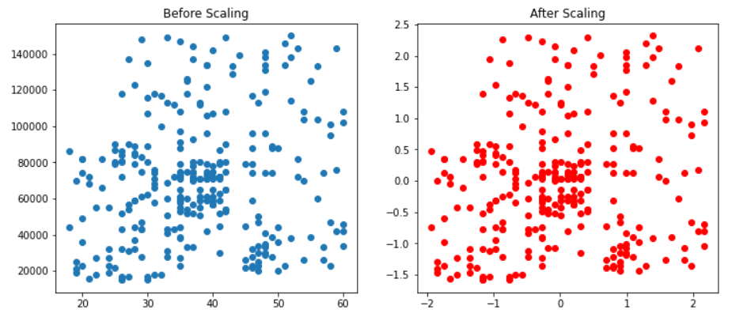
Standardisation
Compare X and Y axis before and after scaling
Mean shifted to 0
Standardisation informed by the mean and std dev
Also referred to as Z-scoring
Implemented in sklearn via the StandardScaler transformer

Slide 7
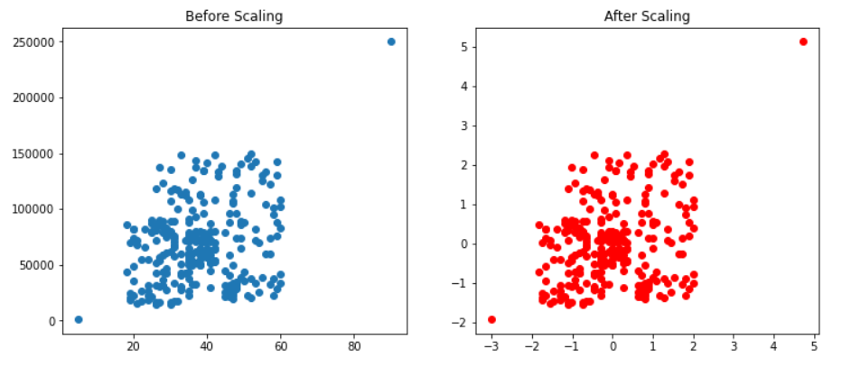
Standardisation
Scaling doesn’t remove outliers unfortunately

Slide 8
Normalisation
Similar to scaling, but uses the min and max to rescale the data
Naturally influenced more heavily by outliers compared to standardisation
Typically rescales data into a fixed range i.e. 0 to 1 or -1 to 1
Implemented in sklearn via the MinMaxScaler transformer

Slide 9
Exercise
Lets practice in Jupyter

Slide 10
Bias
Bias is the difference between the average prediction of our model and the correct value which we are trying to predict.
Model with high bias pays very little attention to the training data and oversimplifies the model.
It always leads to high error on training and test data.
Model is too simple/basic.
High bias = Underfitting.

Slide 11
Variance
Variance is the variability of model prediction for a given data point or a value which tells us spread of our data.
Model with high variance pays a lot of attention to training data and does not generalize on the data which it hasn’t seen before.
As a result, such models perform very well on training data but has high error rates on test data.
High variance = Overfitting.

Slide 12

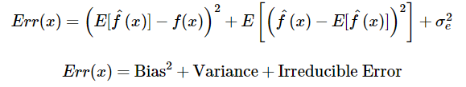
Formulas
Err(x) is the sum of bias², variance and the irreducible error.
Irreducible error is the error that can’t be reduced by creating good models. It is a measure of the amount of noise in our data.
Here it is important to understand that no matter how good we make our model, our data will have certain amount of noise or irreducible error that can’t be removed.

Slide 13
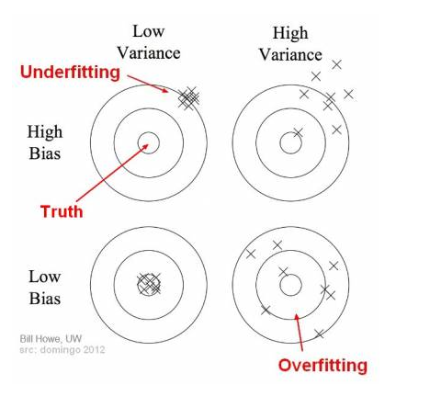
Bulls eye
In the diagram, the centre of the target is a model that perfectly predicts values.
As we move away from the bulls-eye our predictions become worse and worse.

Slide 14
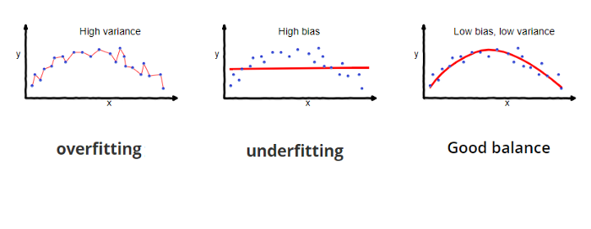
Underfitting
In supervised learning, underfitting happens when a model unable to capture the underlying pattern of the data.
These models usually have high bias and low variance.
It happens when we have too little data to build an accurate model or when we try to build a linear model with nonlinear data.

Slide 15
Overfitting
In supervised learning, overfitting happens when our model captures the noise along with the underlying pattern in data.
It happens when we train our model a lot over noisy dataset.
These models have low bias and high variance.

Slide 16
Trade-off
If our model is too simple and has very few parameters then it may have high bias and low variance. On the other hand if our model has large number of parameters then it’s going to have high variance and low bias. So we need to find the right/good balance without overfitting and underfitting the data.
This trade-off in complexity is why there is a trade-off between bias and variance. An algorithm can’t be more complex and less complex at the same time.

Slide 17
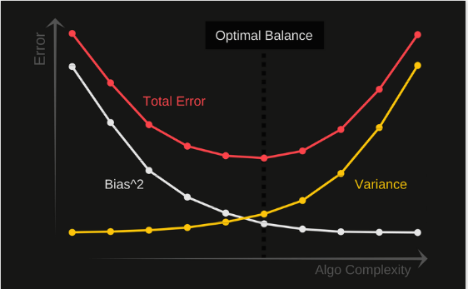
Total error
To build a good model, we need to find a good balance between bias and variance such that it minimizes the total error.
An optimal balance of bias and variance would never overfit or underfit the model.
Therefore understanding bias and variance is critical for understanding the behaviour of prediction models.

Slide 18
Parameters vs hyperparameters
A machine learning algorithm estimates model parameters for a given data set and updates these values as it continues to learn. You can think of a model parameter as a learned value from applying the fitting process.
For example, in logistic regression you have model coefficients. In a neural network, you can think of neural network weights as a parameter. Hyperparameters or tuning parameters are meta-parameters that influence the fitting process itself.

Slide 19

L1 regularisation
Known as Lasso Regression
Adds absolute value of magnitude of coefficient as a penalty term to the loss function.
Again, if lambda is zero then we will get back normal regression whereas very large value will make coefficients zero hence it will under-fit.

Slide 20
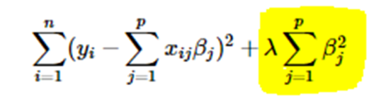
L2 regularisation
Known as Ridge Regression
Adds a squared magnitude of coefficient as a penalty to the loss function (error)
Here, if lambda is zero then you can imagine we get back normal regression. However, if lambda is very large then it will add too much weight and it will lead to under-fitting. Having said that it’s important how lambda is chosen. This technique works very well to avoid over-fitting issue.

Slide 21
L1 vs L2
The key difference between these techniques is that Lasso shrinks the less important feature’s coefficient to zero thus, removing some feature altogether. So, this works well for feature selection in case we have a huge number of features.

Slide 22
Exercise
Lets practice in Jupyter

